Slide 1
Object Recognition using Classical Machine Learning (Track 1)
Exploring Feature Engineering with HOG + SVM/KNN on CIFAR-10

Slide 2

Contents
Introduction
EDA
Pre-Processing
Data partitioning
Architecture
Training
Evaluation
Strengths & Weaknesses
Comparative Insights
Code
Conclusion
References

Slide 3
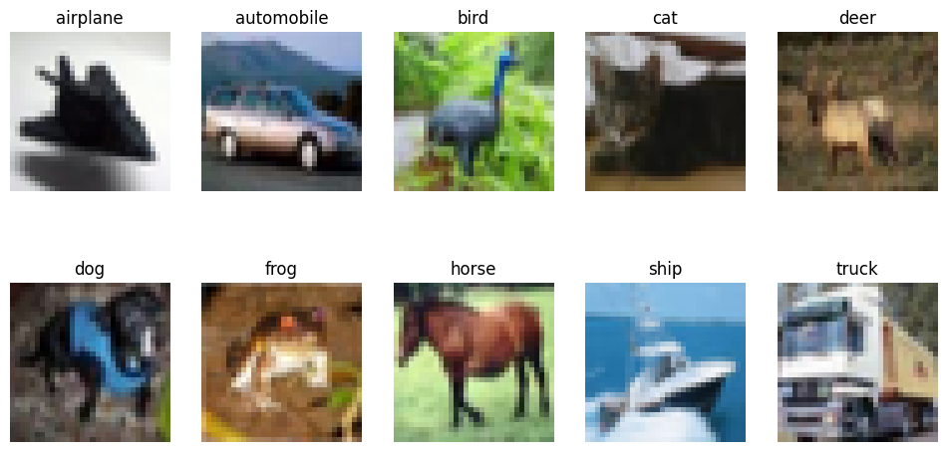
Introduction
Object recognition is a crucial component of many modern AI applications, including autonomous vehicles, surveillance, and biometric systems.
The CIFAR-10 dataset provides a benchmark for image classification tasks. It contains 60,000 32x32 color images categorized into 10 classes (Krizhevsky et al., 2009).
In this study, we use a classical machine learning pipeline combining Histogram of Oriented Gradients (HOG) features with Support Vector Machines (SVM) and K-Nearest Neighbors (KNN) classifiers.
The aim is to assess how well traditional ML models can handle visual object recognition tasks using hand-crafted features rather than deep learning.

Slide 4
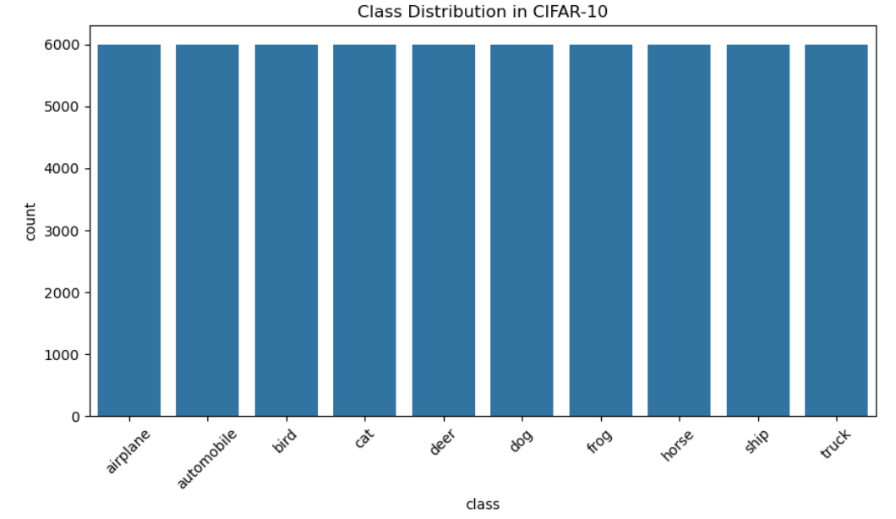
Exploratory Data Analysis (EDA)
CIFAR-10 has balanced classes (6,000 images per class).
Images are 32x32 RGB.
Visualization: Diverse objects, high intra-class variance.
Challenge: Low resolution, complex patterns—unsuitable for raw ML input without feature engineering.

Slide 5
Pre-Processing
Images were normalised by scaling pixel values to the range [0, 1].
Feature Extraction:
Converted RGB images to grayscale to simplify computations.
Applied Histogram of Oriented Gradients (HOG) to extract shape and edge-based features.
HOG captures texture and orientation information, which is critical for enabling classical models like SVM and KNN to distinguish object classes effectively (Dalal & Triggs, 2005).

Slide 6
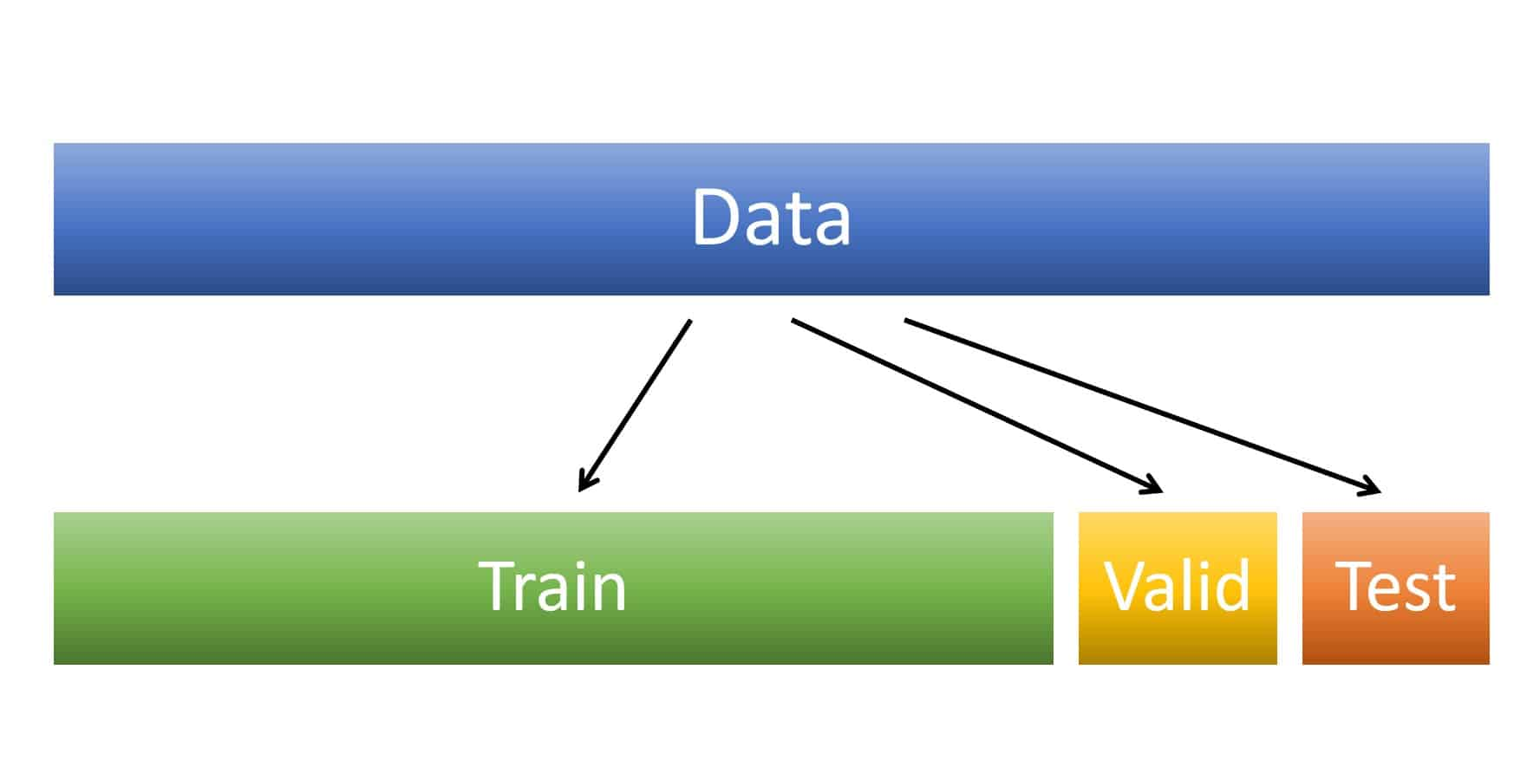
Data Partitioning
Combined CIFAR-10 train & test sets (60,000 images).
Split:
60% Training (36,000)
20% Validation (12,000)
20% Test (12,000)
Stratified sampling ensured class balance in all subsets.

Slide 7
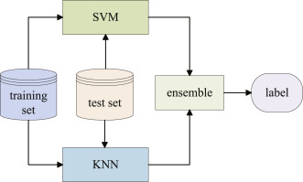
Model Architecture (Classical ML)
Support Vector Machine (SVM):
Linear kernel
C = 1 (regularization)
K-Nearest Neighbors (KNN):
k = 5
Both trained on HOG features (~5,000 dimensions/image).

Slide 8
Training Strategy
Feature extraction via HOG: ~few minutes for 60,000 images.
SVM and KNN trained on 36,000 samples.
No epoch/batch structure—classical models train once.
Validation used for model comparison before testing.
Unlike deep learning, classical models don’t involve iterative training with loss curves (Rawat & Wang, 2017). Instead, the models were trained once on precomputed HOG features, using the scikit-learn framework (Pedregosa et al., 2011).

Slide 9
Evaluation – SVM (Validation)
Accuracy: 52.15%
Stronger on structured classes (e.g., trucks, cars).
Confusion Matrix: Shows confusion among animals (dog, cat, deer).
Macro F1: ~0.52 → fair generalization

Slide 10
Evaluation – KNN (Validation)
Accuracy: 46.79%
Higher recall for simple shapes (e.g., class 1, class 6).
Struggled with high-dimensional HOG space.
Confusion Matrix: Heavy confusion for animal classes.

Slide 11
Test Set Evaluation
SVM:
Accuracy: 52.39%
Consistent with validation
Best for: Airplane, Truck
KNN:
Accuracy: 47.05%
Recall bias towards simple structured classes
HOG + Linear SVM > HOG + KNN on both sets.

Slide 12
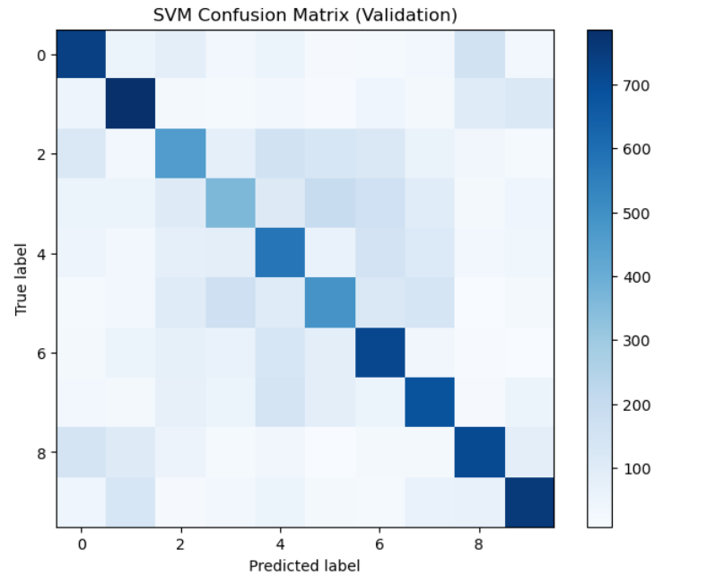
Confusion Matrix - SVM
The SVM confusion matrix shows an overall test accuracy of 52.4%, with strong performance on digits like 0, 1, and 9, which have the highest correct predictions. However, the model struggles with digits such as 2, 3, 4, and 5, where frequent misclassifications occur due to overlapping features. For example, class 3 is often confused with classes 4, 5, and 6. This indicates that while the model handles some classes well, it has difficulty distinguishing between similar-looking digits, suggesting the need for better feature representation or a more advanced model.

Slide 13
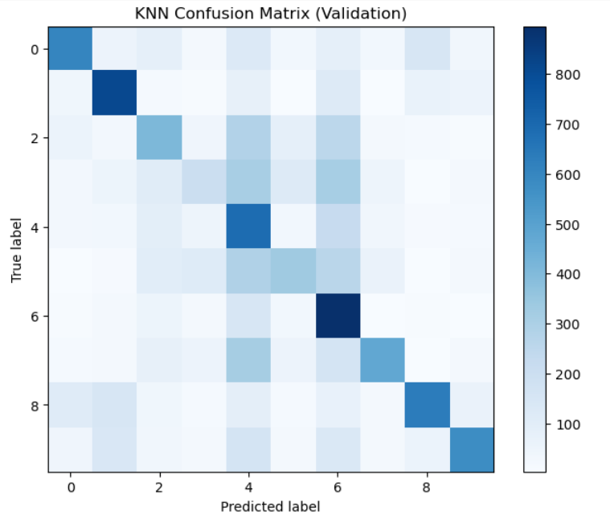
Confusion Matrix - KNN
The K‑nearest‑neighbours model achieves only 47 % accuracy, so just under half of the 12 000 test digits are placed in the right class. It does best on digit 1 (67 % recall), digit 6 (74 %) and digit 4 (57 %), but these gains are offset by heavy confusion elsewhere:
Digit 3 is mistaken for 4 or 6 almost twice as often as it is recognised (only 207/1200 correct).
Digit 5 is split across 4 and 6, giving it a recall of 29 %.
Digit 2 frequently falls into 4, 5 and 6, while digits 8 and 9 are often swapped with 0 and 1.
Overall, the matrix shows that KNN handles a few classes well but struggles with those that have overlapping pixel patterns, producing broad off‑diagonal bands of errors. Better feature extraction or a more discriminative model would be needed to push accuracy higher.

Slide 14
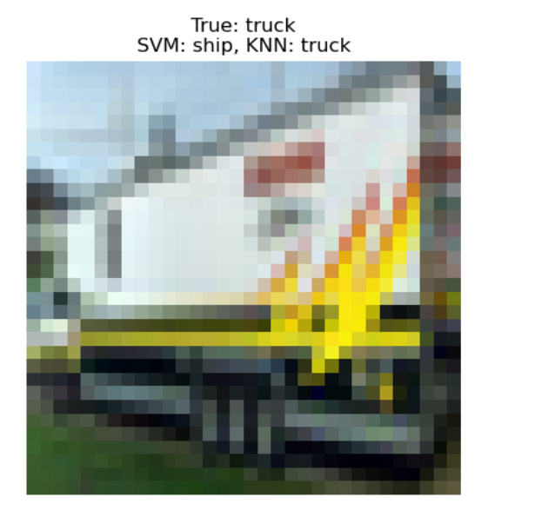
Single Image Test

Slide 15
Strengths & Weaknesses
Strengths
Simple & Interpretable: Easy to implement and analyze.
No need for large GPU resources: Efficient on CPU.
Effective with limited data: Performs reasonably well without massive datasets.
HOG captures shape/orientation features: Good for structured patterns (e.g., edges, contours) (Dalal & Triggs, 2005).
Weaknesses
Lower accuracy on complex datasets like CIFAR-10: Can't capture high-level abstract features (e.g., textures, context).
No end-to-end learning: Feature extraction (HOG) is fixed, not optimized with classification.
Scalability issues:
SVMs are slow on large datasets.
KNN is memory-heavy and slow during prediction.
No training curves: Harder to monitor learning progress (unlike deep learning models).

Slide 16

Comparative Insights
Metric | SVM | KNN
Accuracy | 52.4% | 47.0%
Precision | Moderate | Lower
Confusion | Balanced | More class confusion
Train Speed | Slower | Faster
Trade-Offs:
SVM generalizes better in high-dimensional HOG space.
KNN suffers due to curse of dimensionality.

Slide 17
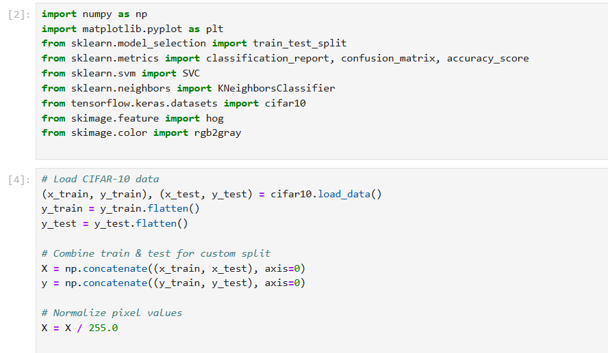
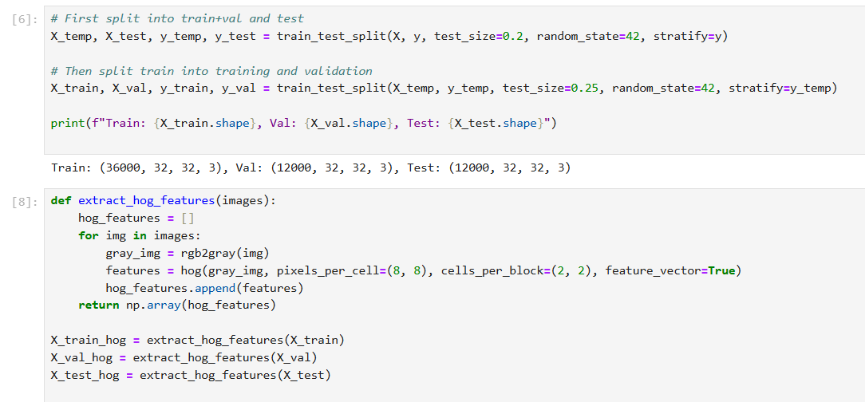
Code

Slide 18
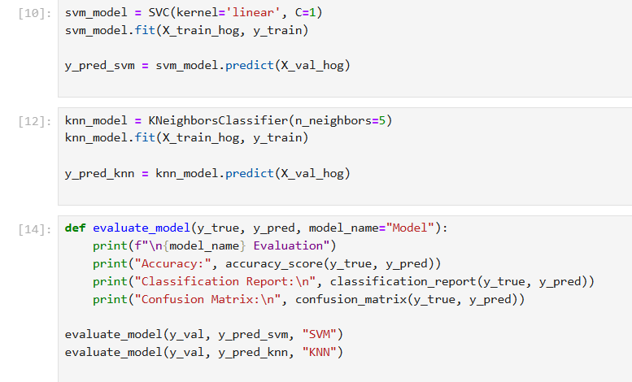
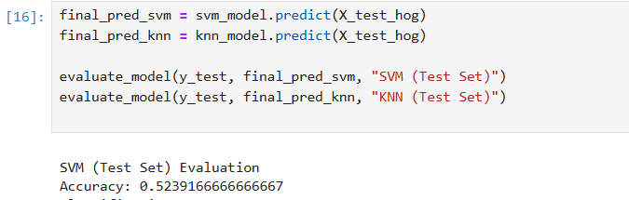

Slide 19
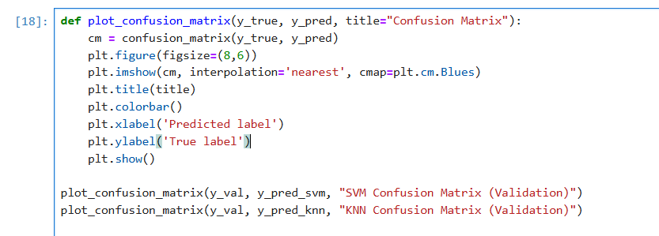

Slide 20
Conclusion
Classical ML still viable with good feature engineering.
HOG + SVM provides modest performance on CIFAR-10.
Animal classes harder due to complex texture.
Deep learning likely outperforms due to automatic feature learning.

Slide 21
References
Cortes, C., & Vapnik, V. (1995). Support-vector networks. Machine Learning, 20(3), 273–297. Available at: https://doi.org/10.1007/BF00994018 (Accessed: 11 July 2025).
Cover, T., & Hart, P. (1967). Nearest neighbor pattern classification. IEEE Transactions on Information Theory, 13(1), 21–27. Available at: https://doi.org/10.1109/TIT.1967.1053964 (Accessed: 11 July 2025).
Dalal, N., & Triggs, B. (2005). Histograms of Oriented Gradients for Human Detection. In Proceedings of the IEEE Computer Society Conference on Computer Vision and Pattern Recognition (CVPR), 886–893. Available at: https://doi.org/10.1109/CVPR.2005.177 (Accessed: 12 July 2025).
Krizhevsky, A. (2009). Learning Multiple Layers of Features from Tiny Images. Technical Report, University of Toronto. Available at: https://www.cs.toronto.edu/~kriz/cifar.html (Accessed: 12 July 2025).
Pedregosa, F., et al. (2011). Scikit-learn: Machine Learning in Python. Journal of Machine Learning Research, 12, 2825–2830. Available at: https://www.jmlr.org/papers/v12/pedregosa11a.html (Accessed: 13 July 2025).
Rawat, W., & Wang, Z. (2017). Deep Convolutional Neural Networks for Image Classification: A Comprehensive Review. Neural Computation, 29(9), 2352–2449. Available at: https://doi.org/10.1162/neco_a_00990 (Accessed: 14 July 2025).

